Slide 1
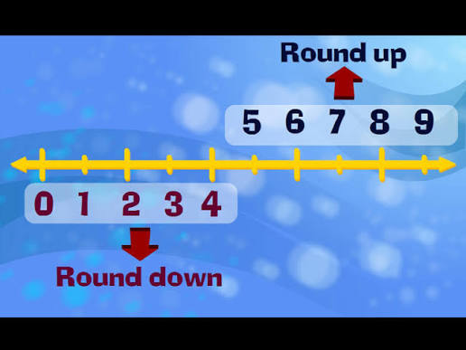
PROJECT REPORT OF SUMMER
INTERSHIP
TOPIC:-
ROUND OFF,ROUND UP,& ROUND DOWN
Submitted to:- Shashwat Singhal
Submitted by:-Unnati Chaurasia

Slide 2
WHAT IS ROUND OFF?
Round Off is the process of simplifying a number by reducing the number of digits while keeping its value as close as possible to the original number. It helps make calculations easier and numbers easier to understand.
Rounding is commonly used in mathematics, accounting, finance, taxation, statistics, and everyday calculations when exact values are not necessary.
Example:- 45.67 → 45.7 (rounded to one decimal place),23.4 → 23 (rounded to the nearest whole number) , 78.95 → 79 (rounded to the nearest whole number) ,62.13 → 62 (rounded to the nearest whole number).

Slide 3
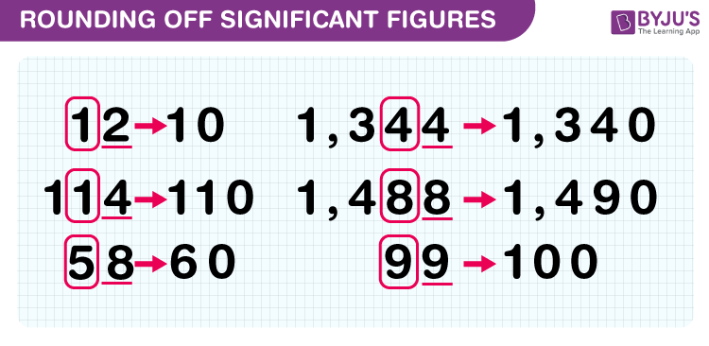
RULES OF ROUND OFF
Identify the digit to which you want to round.
Look at the digit immediately to its right.
If that digit is 5 or greater (5–9), increase the previous digit by 1.
If that digit is less than 5 (0–4), keep the previous digit unchanged.
Remove the remaining digits.

Slide 4
WHAT IS ROUND UP ?
Round Up is a rounding method in which a number is always increased to the next higher whole number or specified place value, regardless of the decimal value (if there is any decimal part).
In simple words, if a number contains a decimal portion, it is rounded to the next greater integer.
Examples
12.1 → 13
25.6 → 26
7.01 → 8
45.99 → 46

Slide 5
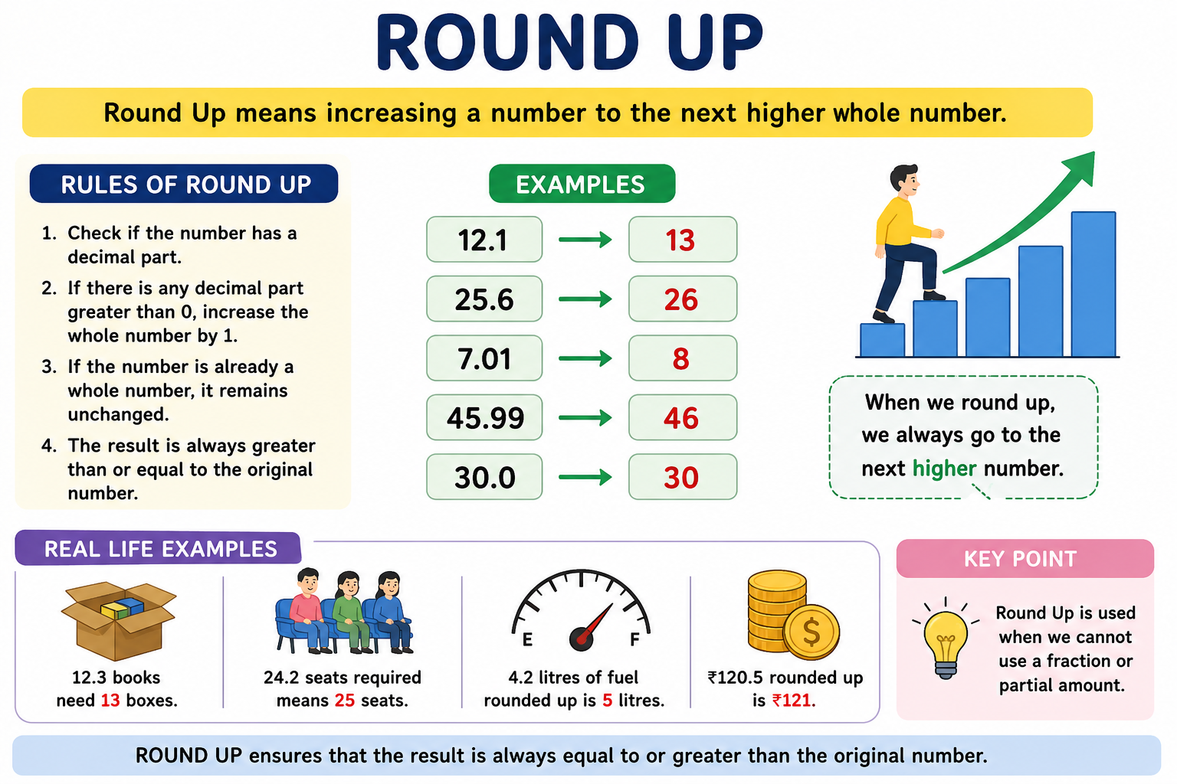
RULES OF ROUND UP
Identify the number that needs to be rounded.
Check for a decimal part in the number.
If there is any decimal value greater than 0, increase the whole number by 1.
If the number is already a whole number, it remains unchanged.
The rounded value is always greater than or equal to the original number.

Slide 6
WHAT IS ROUND DOWN?
Round Down is a method of rounding in which a number is reduced to the next lower whole number by removing its decimal part. The value is always rounded toward a smaller number, regardless of the decimal digits.
Round Down is commonly used in mathematics, accounting, finance, statistics, and everyday calculations when only completed units or whole numbers are considered.
Example:-
15.9 → 15
The decimal part (.9) is ignored, so the number becomes 15.
22.7 → 22
The decimal part (.7) is removed, leaving 22.
100.8 → 100
The decimal part (.8) is ignored, so the result is 100.

Slide 7
RULES OF ROUND DOWN
Identify the number to be rounded.
Look at the whole number part.
Ignore or remove all digits after the decimal point.
Keep only the whole number.
The rounded value will always be less than or equal to the original number.

Slide 8
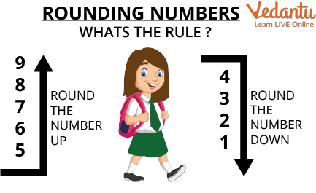
Difference between round up &round down
Round Up:-
Examples:
12.3 → 13
25.1 → 26
99.9 → 100
Round Down:-
Examples:
12.3 → 12
25.1 → 25
99.9 → 99

Slide 9
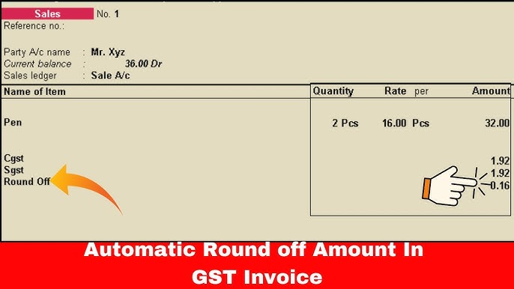
Round Off in GST and Taxation
Tax amounts are often rounded to the nearest rupee.
Simplifies tax payment and filing.
Reduces calculation errors.
Helps maintain consistency in records.

Slide 10
ROUND UP IN DAILY LIFE
Number of seats required.
Packing and shipping quantities.
Hotel room bookings.
Resource allocation.

Slide 11
ROUND DOWN IN DAILY LIFE
Budget planning.
Estimating available resources.
Recording completed units only.
Calculating age in completed years.

Slide 12
CONCLUSION
Round Off, Round Up, and Round Down are important mathematical techniques used to simplify numbers and make calculations easier. Round Off gives the nearest value, Round Up always increases the number to the next higher value, and Round Down always decreases it to the next lower value. These methods are widely used in mathematics, accounting, taxation, finance, business, and everyday life for estimation, reporting, and decision-making. Understanding these rounding methods helps improve accuracy, efficiency, and consistency in numerical calculations.

